Slide 1

Caratterizzazione molecolare di proantocianidine prodotte con green technology da semi d’uva.
Fulvio Ursini
Dipartimento di Medicina Molecolare
Università di Padova

Slide 2
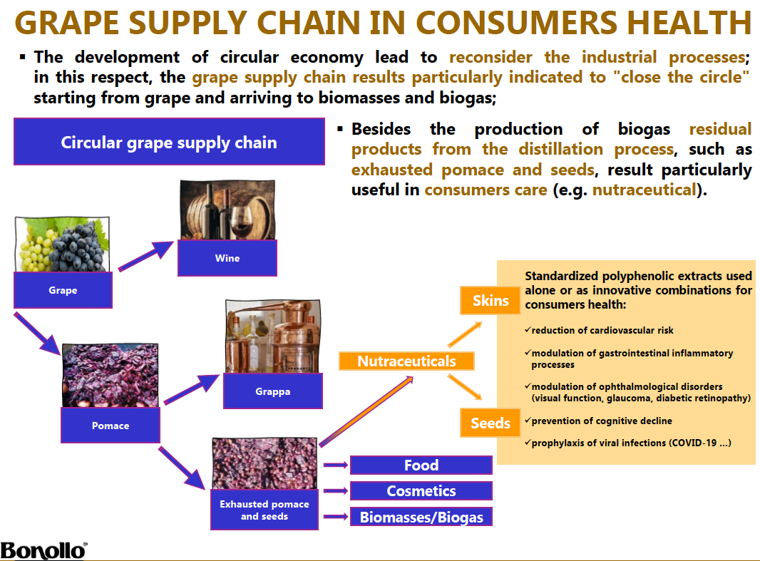

Slide 3
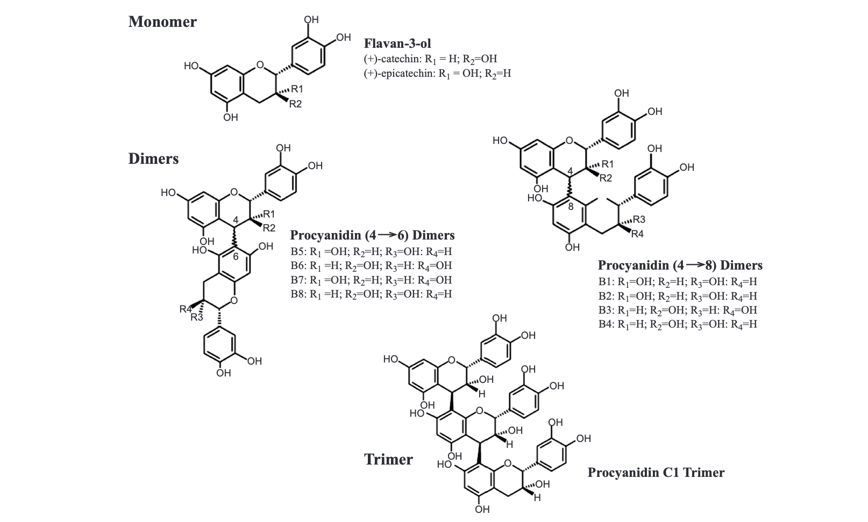
In the last decades, products obtained from grape seeds and characterized by a high polyphenol content have received particular attention due to their nutraceutical effects.
Grape seed extracts (GSE) containing variable amounts of polyphenols and so-called oligomeric proanthocyanidins (PACs) have been investigated in several health conditions

Slide 4

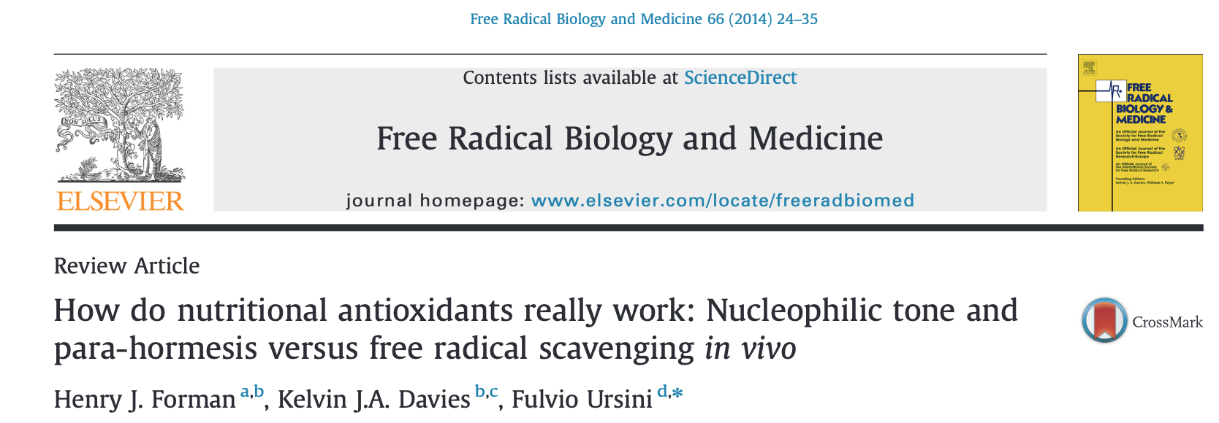
Effetti nutraceutici delle PAC
Antioxidant
Anti-diabetic
Anti-platelets
Anti-cholesterol
Anti-inflammation
Anti-microbial
Anti-tumor
Anti-aging (senolytic?)
Come è compatibile una simile panacea di effetti con un meccanismo comune, definibile in termini nutrizionali e/o farmacologici ?
Un possibile meccanismo recentemente proposto e che accomuna tutte queste condizioni è quello della Ormesi Nutrizionale basato sulla attivazione del fattore nucleare anti-stress Nrf2 ed il controllo della redox homeostasis

Slide 5
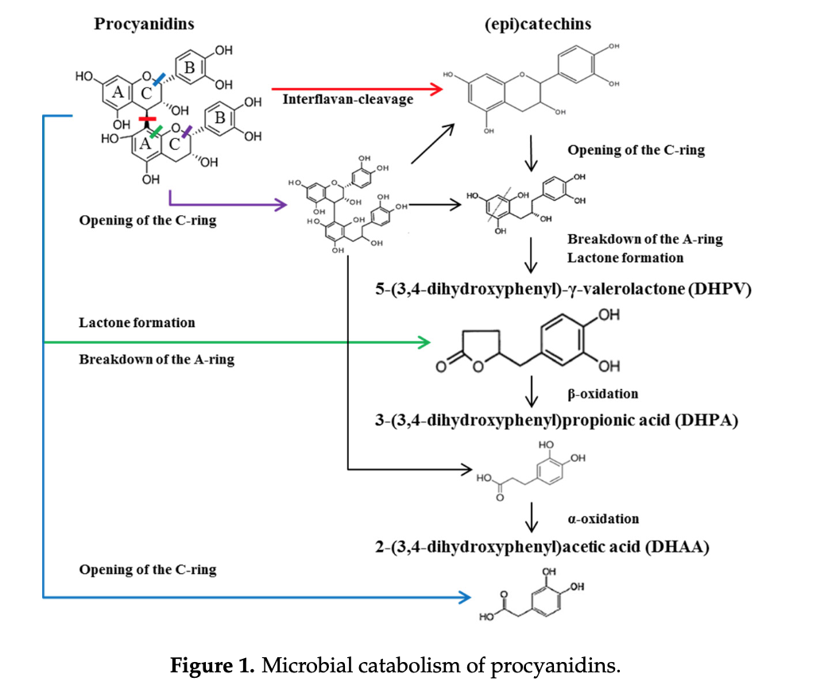

Slide 6
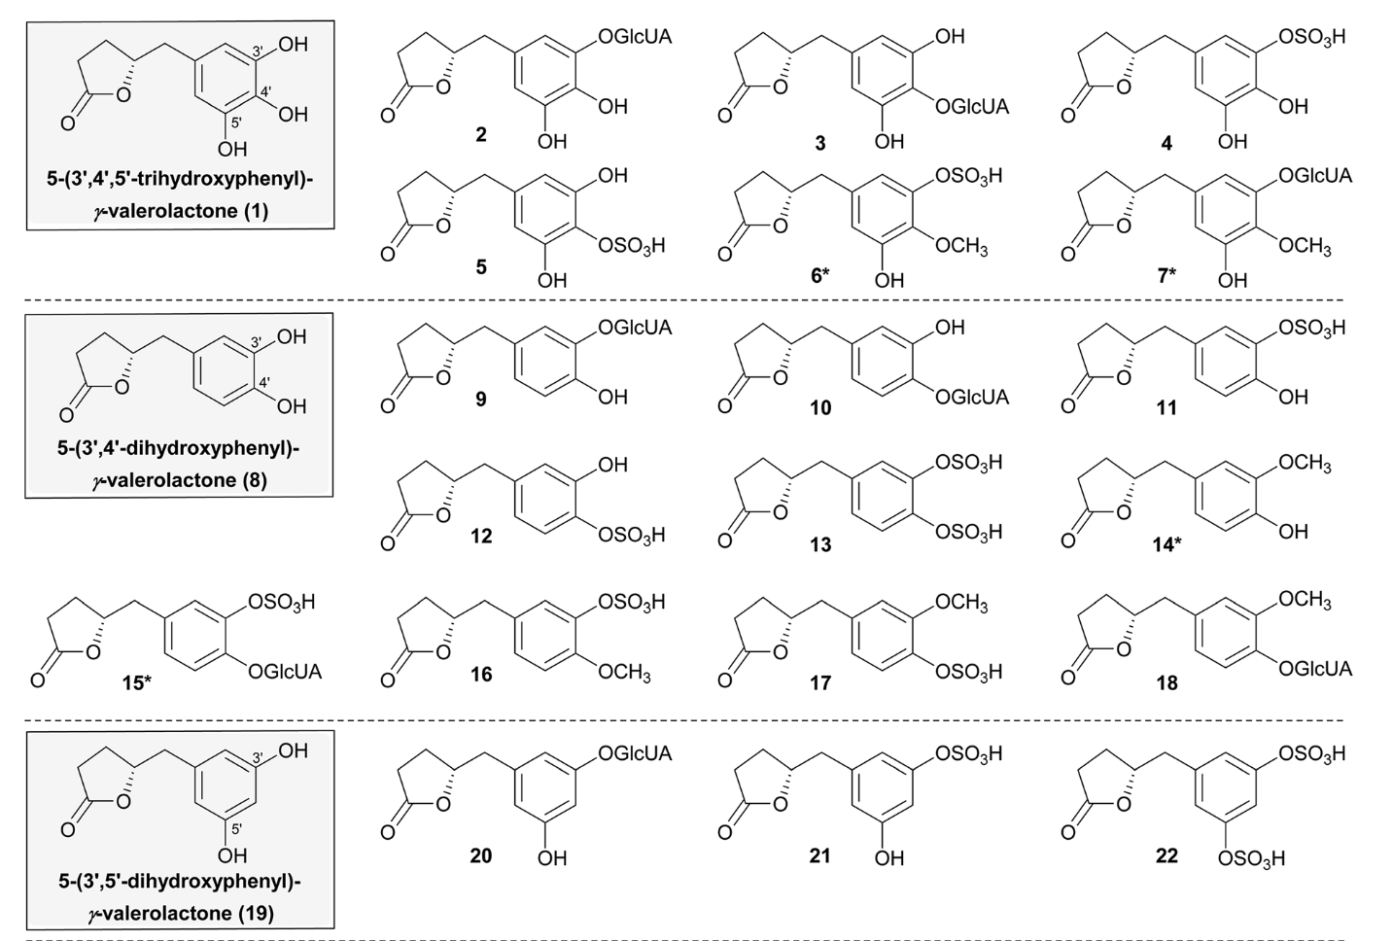

Slide 7
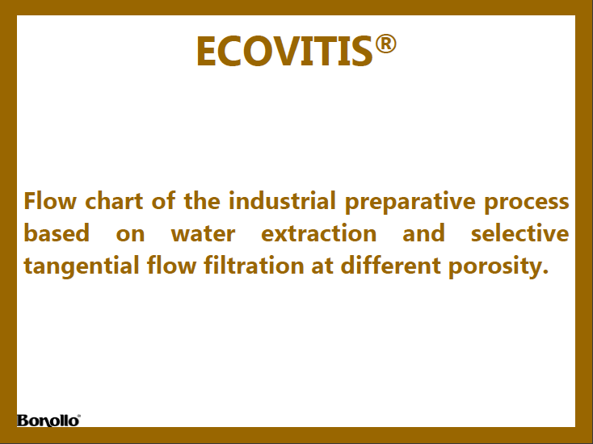

Slide 9
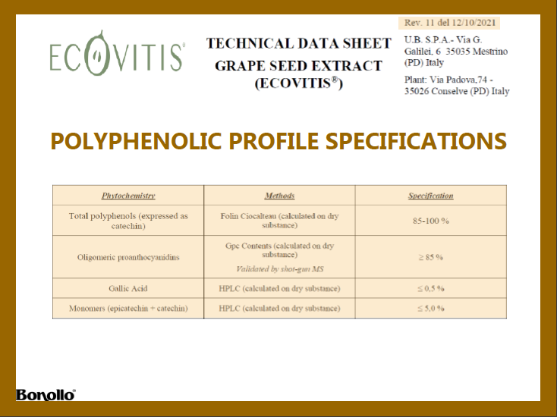

Slide 10

Colorimetric tests such as Folin Ciocalteu and Bate Smith commonly routinely used to test PAC in GSE have a very limited use to testify the quality of the extract and the occurrence of a possible adulteration.
A more accurate characterization integrating different analytical approaches is mandatory.

Slide 11
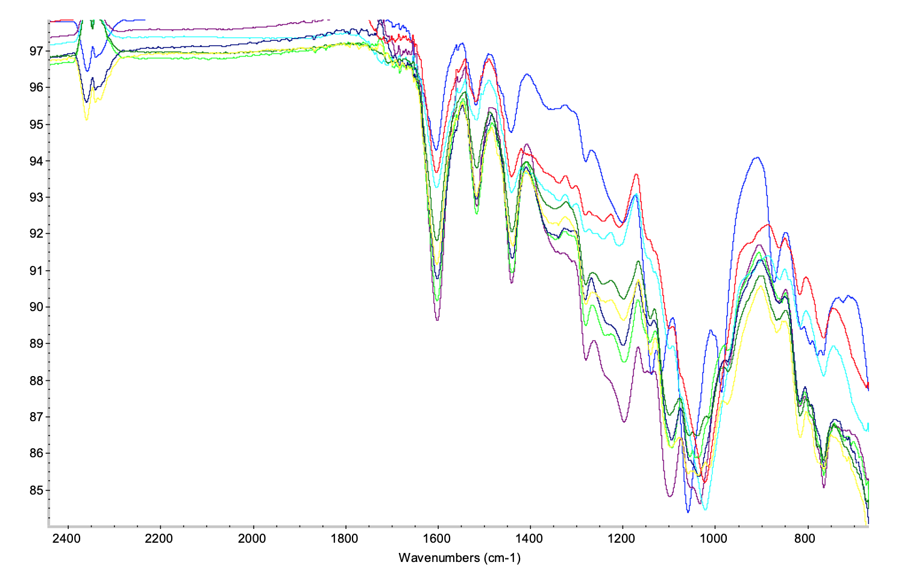
Ecovitis
FTIR spectra of six independent preparations
FTIR spectra of different commercially available GSE

Slide 12
GPC data: (A) Gel permeation chromatograms of procyanidin standards (epicatechin EC, dimer B2, trimer C1, tetramer D, pentamer E) overlaying the chromatogram of Ecovitis™ (blue line). (B) Calibration curves of PACs (GA, TA, EC, ECG, EGC, EGCG, PC-B2, PC-C1, PC-D, PC-E, black squares) and polystyrene (red circles). Arrows indicate the observed linear range for the GPC column.
Antioxidants 2021, 10(3), 418; https://doi.org/10.3390/antiox10030418

Slide 13
GPC profiles of Ecovitis™ (A) blue line: Normalized AU (%); red line: cumulative distribution and median degree of polymerisation (mDP), expressed as the number of catechin units contained at the average molecular weight; (B) Blue line: catechin absorbance (AU); red line: concentration (µmolar) of PACs along GPC profile. The latter was obtained by dividing the molar concentration of catechin equivalents calculated from absorbance for the DP corresponding to the MW in the plot.
Antioxidants 2021, 10(3), 418; https://doi.org/10.3390/antiox10030418

Slide 14
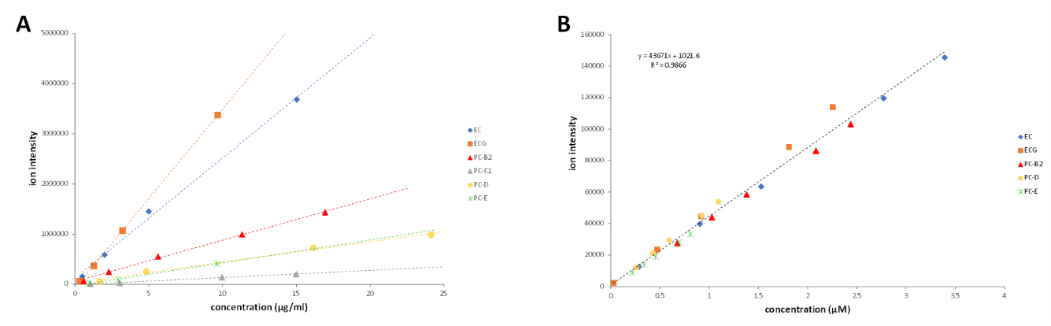
ESI Q-Tof MS matrix-matched calibration curve obtained from linear regression of a single analyte ion volume versus concentration expressed as µg/ml (Plot A) and cumulative data from epicatechin (EC), epicatechin gallate (ECG), procyanidin B2, D and E expressed as µmolar concentration (Plot B).

Slide 15
Representative ESI Q-Tof (shot gun approach) mass spectrum of Ecovitis™. Insert A is the x-axis expanded segment from 600 to 1200 m/z.

Slide 16
Deconvoluted ESI Q-Tof mass spectrum of Ecovitis™ grape seed extract. Compounds are identified with ID number as in Table

Slide 18
In Summary:
A "green" solvent-free industrial process has been adopted for the preparation of the GSE Ecovitis™ using water and selective tangential flow filtration at different porosity.
The characterization has been resolved by using a combination of Gel Permeation Chromatography (GPC) and Mass Spectrometry (MS).
GPC and MS approaches were remarkably well cross-validated by overlapping results
Adopting retention calibration and spectroscopic quantification of catechin as chromophore, GPC quantifies polymers up to traces at n= 30
This sensitivity took advantage of the nanoscale shotgun approach, although paying the limit of missed separation of stereoisomers
This procedure is applied for routine quality control of Ecovitis™

